Slide 1
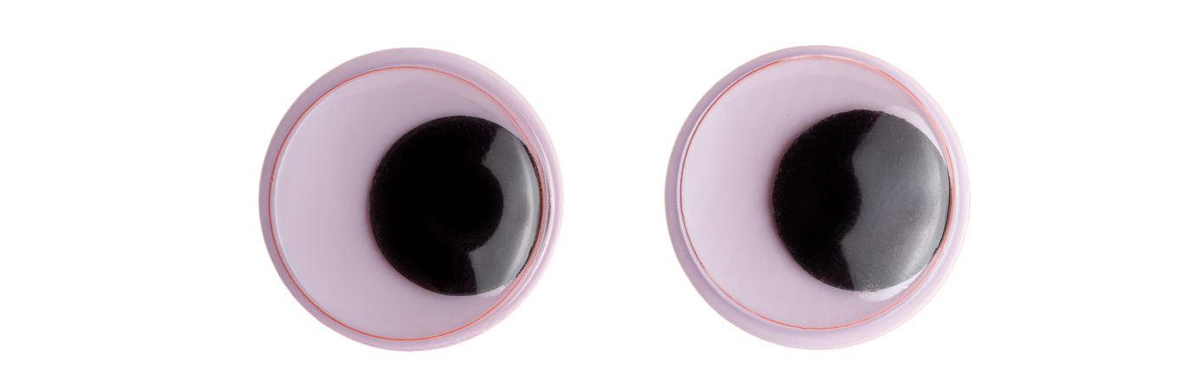
TYPING WITHOUT HANDS
CHONG JING HONG
U1922300B
Notes:
Good afternoon, Professors.
My name is Jing Hong and I will be presenting my Final Year Project titled: Typing Without Hands

Slide 2
AGENDA
01
04
Introduction
User Studies
02
05
System Design & Analysis
Conclusion
03
Implementation
Notes:
This is the agenda for the presentation
I’ll start off with the introduction, and move on to the system design and analysis
Next, I will talk about the implementation of the project and the user studies conducted
Lastly, I will conclude the presentation

Slide 3
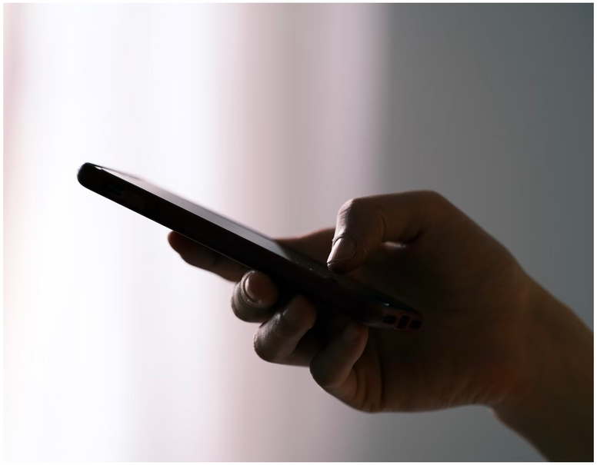

01 INTRODUCTION
6 January 2021
BACKGROUND INFO & MOTIVATION
Typing - an important part of daily our lives
Needed for work, communication etc.
The Past, Present And Future Of Messaging
By Andrea Giacomini
Not everyone can type with their hands
People with Motor Neuron Diseases (MNDs)
Need for alternative typing solution
“... 23 billion texts are sent worldwide each day — that’s 270,000 every second.”
Notes:
Typing has become an important part of our daily lives, as it is required for various activities such as work, communication, education, and more.
According to Forbes, an estimated 270,000 texts were sent every second in 2021
Typing may be easy for many of us, but for people with medical conditions like motor neuron diseases, it may be difficult or even impossible to type using their hands.
Therefore, there is a need to develop an alternative system to allow these groups of people to type.

Slide 4


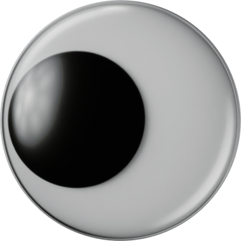

01 INTRODUCTION
BACKGROUND INFO & MOTIVATION
Eye typing
Generate text using one’s gaze as an input mechanism
1. Measures the position of the user’s eyeballs, determines the point at which the user is looking
3. Outputs selected key
Hello World
2. Gaze at the desired key, perform key selection
Notes:
One possible way is through eye typing.
Eye typing is a method of generating text through the use of one’s gaze as an input mechanism
[CLICK]
In most eye typing systems,
[CLICK]
an eye tracking device measures the position of the user’s eyeballs and determines the point at which the user is looking.
[CLICK]
To select a key, the users gaze at the desired key on an onscreen keyboard and performs a key selection.
[CLICK]
The eye typing system detects the key selection and outputs the selected key

Slide 5
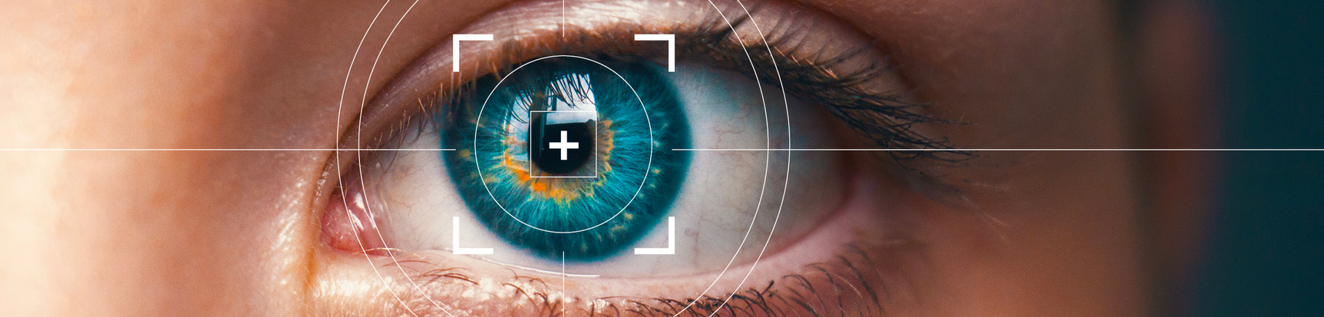
01 INTRODUCTION
PROJECT OBJECTIVES
01
02
03
Develop a low-cost system capable of eye tracking and gaze estimation using a webcam
Design a novel virtual keyboard that can tolerate inaccuracies in eye tracking and gaze estimation
Conduct user studies that compare the performance of the novel keyboard against the QWERTY keyboard.
Notes:
With that in mind, these are the objectives of the project
[CLICK]
The first objective is to develop a low-cost system capable of eye tracking and gaze estimation using a webcam.
[CLICK]
The second objective is to design a novel virtual keyboard that can tolerate inaccuracies from eye tracking and gaze estimation.
[CLICK]
The final objective is to conduct user studies that compare the performance of the novel keyboard against the QWERTY keyboard to evaluate the usability and effectiveness of the new system. The evaluation metrics are:
The typing speed
the typing accuracy
and the overall user satisfaction.

Slide 6
02 SYSTEM DESIGN & ANALYSIS
EYE TYPING SYSTEM
Eye Tracking
Gaze Estimation
Key Selection
Appearance-based
use the photometric appearance of the eyes to detect and track them
Highly performant under different environmental conditions
Google’s MediaPipe FaceMesh
Appearance-based
estimate the gaze direction based on the appearance of the eye
Standard machine learning algorithms
Short training time with high accuracies
Drawbacks:
Fixed head pose – enforced through chin rest
Dwell selection
Balance between accuracy and ease of implementation
Notes:
Moving on to the system design and analysis of eye typing system, I’ve split the eye typing system into 3 components:
Eye tracking
Gaze Estimation
Key selection
[CLICK]
For eye tracking, an appearance-based technique was used. Appearance-based eye tracking use photometric appearance of the eyes to detect and track them. This is because appearance-based eye tracking is highly performant under different environmental conditions, making it more accurate than the other approaches. In this project, Google’s MediaPipe FaceMesh was utilized for this purpose.
[CLICK]
For gaze estimation, I opted for an appearance-based technique that utilized standard machine learning algorithms. This was mainly due to the algorithms having minimal training time but yielding high accuracies. However, one drawback of this approach is that it requires a fixed head pose, which I enforced by using a chin rest.
[CLICK]
The dwell selection method was chosen as the key selection method. This is because it provides a good balance between accuracy and ease of implementation.

Slide 7
02 SYSTEM DESIGN & ANALYSIS
EYE TYPING SYSTEM
EYE TRACKING
Method: Appearance-based
Use the photometric appearance of the eyes to detect and track them
Highly performant under different environmental conditions
Google’s MediaPipe FaceMesh
Notes:
Moving on to the system design and analysis of eye typing system, I’ve split the eye typing system into 3 components:
Eye tracking
Gaze Estimation
Key selection
[CLICK]
For eye tracking, an appearance-based technique was used. Appearance-based eye tracking use photometric appearance of the eyes to detect and track them. This is because appearance-based eye tracking is highly performant under different environmental conditions, making it more accurate than the other approaches. In this project, Google’s MediaPipe FaceMesh was utilized for this purpose.
[CLICK]
For gaze estimation, I opted for an appearance-based technique that utilized standard machine learning algorithms. This was mainly due to the algorithms having minimal training time but yielding high accuracies. However, one drawback of this approach is that it requires a fixed head pose, which I enforced by using a chin rest.
[CLICK]
The dwell selection method was chosen as the key selection method. This is because it provides a good balance between accuracy and ease of implementation.

Slide 8
02 SYSTEM DESIGN & ANALYSIS
EYE TYPING SYSTEM
GAZE ESTIMATION
Method: Appearance-based
Estimates the gaze direction based on the appearance of the eye captured by a model
Standard machine learning algorithms
Short training time with high accuracies
Drawbacks:
Fixed head pose – enforced through chin rest
Notes:
Moving on to the system design and analysis of eye typing system, I’ve split the eye typing system into 3 components:
Eye tracking
Gaze Estimation
Key selection
[CLICK]
For eye tracking, an appearance-based technique was used. Appearance-based eye tracking use photometric appearance of the eyes to detect and track them. This is because appearance-based eye tracking is highly performant under different environmental conditions, making it more accurate than the other approaches. In this project, Google’s MediaPipe FaceMesh was utilized for this purpose.
[CLICK]
For gaze estimation, I opted for an appearance-based technique that utilized standard machine learning algorithms. This was mainly due to the algorithms having minimal training time but yielding high accuracies. However, one drawback of this approach is that it requires a fixed head pose, which I enforced by using a chin rest.
[CLICK]
The dwell selection method was chosen as the key selection method. This is because it provides a good balance between accuracy and ease of implementation.

Slide 9
02 SYSTEM DESIGN & ANALYSIS
EYE TYPING SYSTEM
KEY SELECTION
Method: Dwell Selection
Key is selected if user’s gaze is fixated on it for more than some predetermined time
Balance between accuracy and ease of implementation
Notes:
Moving on to the system design and analysis of eye typing system, I’ve split the eye typing system into 3 components:
Eye tracking
Gaze Estimation
Key selection
[CLICK]
For eye tracking, an appearance-based technique was used. Appearance-based eye tracking use photometric appearance of the eyes to detect and track them. This is because appearance-based eye tracking is highly performant under different environmental conditions, making it more accurate than the other approaches. In this project, Google’s MediaPipe FaceMesh was utilized for this purpose.
[CLICK]
For gaze estimation, I opted for an appearance-based technique that utilized standard machine learning algorithms. This was mainly due to the algorithms having minimal training time but yielding high accuracies. However, one drawback of this approach is that it requires a fixed head pose, which I enforced by using a chin rest.
[CLICK]
The dwell selection method was chosen as the key selection method. This is because it provides a good balance between accuracy and ease of implementation.

Slide 10
02 SYSTEM ANALYSIS & DESIGN
EYE TYPING SYSTEM
FUNCTIONAL REQUIREMENTS
NON-FUNCTIONAL REQUIREMENTS
Detect users’ eyes and track their positions in real time.
Estimate where users are gazing and move the cursor accordingly in real time.
Detect if a key has been selected via dwell selection.
Record all the keys selected by users and display the transcribed text.
Run steadily at 30 frames per second, to ensure a smooth user experience.
Chin rest must be at an appropriate height and distance away from the display so that users can see the whole screen.
Chin rest must be comfortable for users to rest their chins.
Notes:
These are the functional requirements of the eye typing system:
The eye typing system must….
[CLICK]
Next, these are the non-functional requirements of the eye typing system:
The eye typing system must

Slide 11
02 SYSTEM ANALYSIS & DESIGN
NOVEL KEYBOARD
FUNCTIONAL REQUIREMENTS
Have larger-than-normal keys.
To compensate for inaccuracies in eye tracking and gaze estimation
Keys are selectable via dwell selection.
Outputs the correct key or function.
Feedback to tell users the amount of dwell time left and where the cursor is hovering.
Have the following keys:
Numbers (0 - 9)
Uppercase and lowercase letters
Special characters (!@#$%^&*()-=_+[]\{}|;’:”,./<>?)
Delete
Enter
Shift
Space
Notes:
These are the functional requirements of the LTNK keyboard:
The keyboard must…

Slide 12
02 SYSTEM ANALYSIS & DESIGN
NOVEL KEYBOARD
NON-FUNCTIONAL REQUIREMENTS
Intuitive layout
Users must be able to understand what each button does without explanation
Users must be able to see the output of the key selection immediately.
Notes:
These are the non-functional requirements of the LTNK keyboard:
The keyboard must…

Slide 13
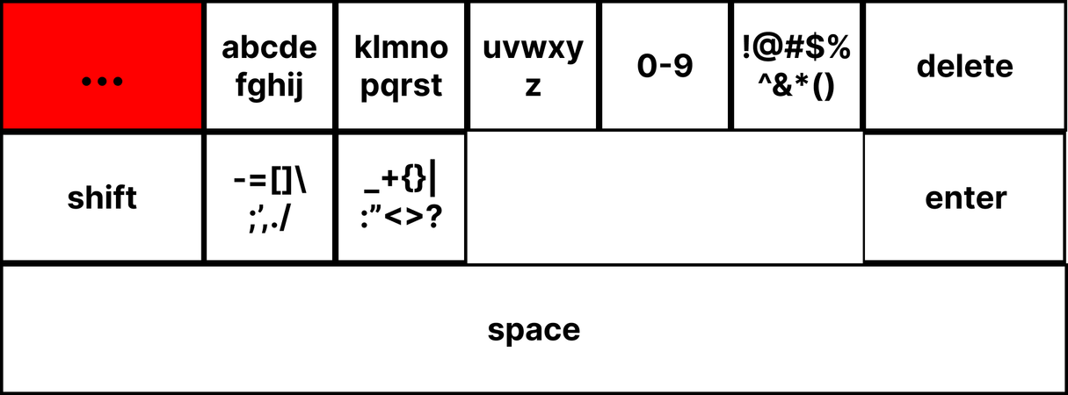
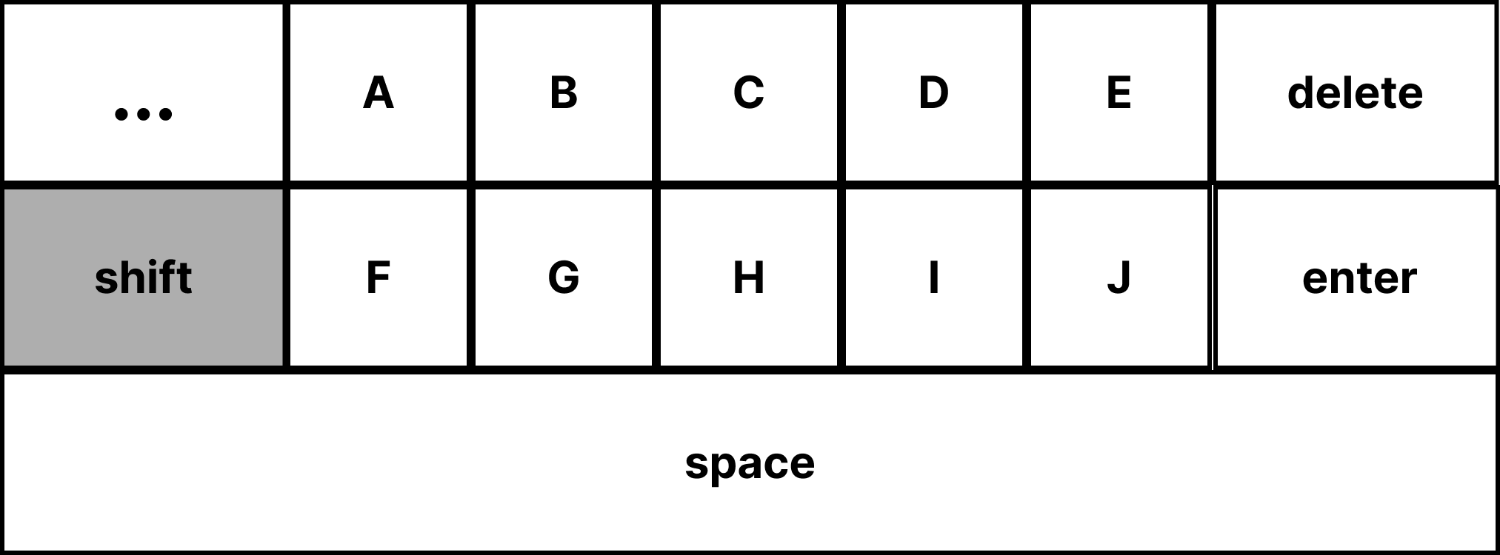
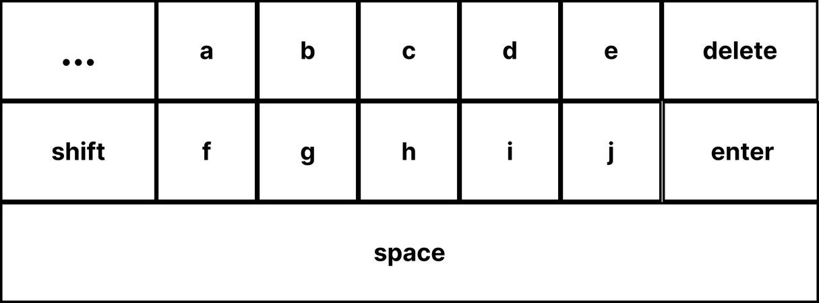
02 SYSTEM ANALYSIS & DESIGN
NOVEL KEYBOARD - LTNK KEYBOARD
Displays the keyboard keys that are grouped together
Level One
Displays individual keys for more detailed input
Level Two
Notes:
This is the design of the novel keyboard called LTNK keyboard. The LTNK keyboard features a two-level hierarchical design.
[CLICK]
The level one page displays the keyboard keys that are grouped together
[CLICK]
while the level two pages display individual keys for more detailed input.
[CLICK]
To facilitate ease of use, five larger buttons are present on all pages.
[CLICK]
These buttons are the ‘...’ back button, shift button, delete button, enter button, and space button.
[CLICK]
Alphabetic and numeric keys are arranged in order while special character keys are grouped based on their proximity to each other on the QWERTY keyboard layout.
[CLICK]
The LTNK keyboard also provides visual feedback to users whenever a key has been selected or is unavailable to use by highlighting the keys in grey and red respectively.

Slide 14
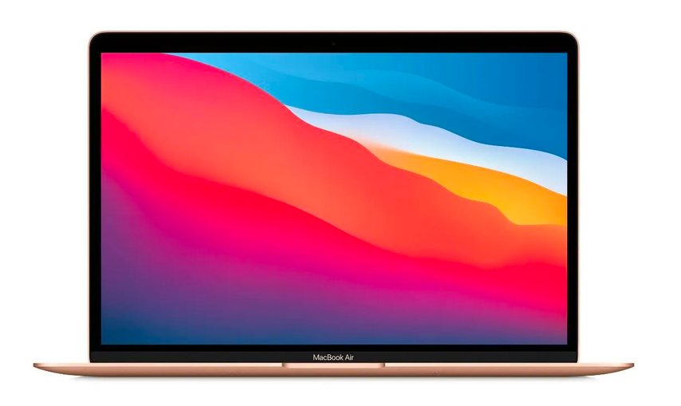
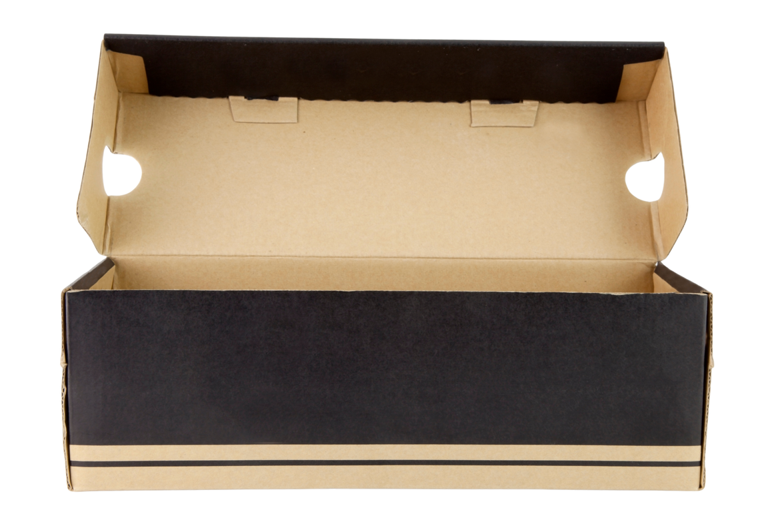

02 SYSTEM ANALYSIS & DESIGN
HARDWARE REQUIREMENTS
MacBook Air (2020)
Apple M1 processor
16GB memory
macOS Ventura 13.2.1
720p FaceTime HD camera
13.3-inch display
Chin Rest
Shoebox of height 11.1cm
Book of height 3.4cm
Book of height 2.4cm
Notes:
These are the hardware resources used for this project

Slide 15








02 SYSTEM ANALYSIS & DESIGN
SOFTWARE REQUIREMENTS
PACKAGES
PYNPUT
Python
Version 3.9.15
Notes:
These are the software resources that were used.
The project was coded in Python and to the right are all the Python packages that were used

Slide 16
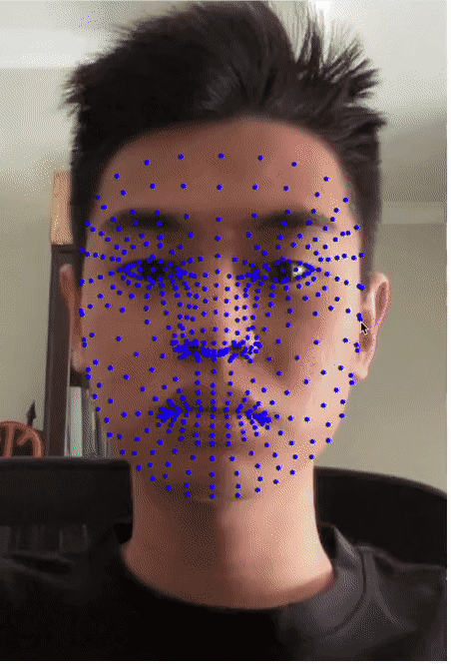
03 IMPLEMENTATION
EYE TRACKING
OpenCV
Capture images continuously from webcam
MediaPipe FaceMesh
Process images, detect facial landmarks
468 facial landmarks, including eye centres
Notes:
I will now delve into the implementation of the eye typing system
[CLICK]
For the eye tracking, a combination of OpenCV and Google’s MediaPipe FaceMesh were used.
Using OpenCV, images are captured continuously from the laptop webcam.
[CLICK]
The captured images are then processed by FaceMesh, whereby a total of 468 facial landmarks will be detected, including the centres of the left and right eyes.

Slide 17
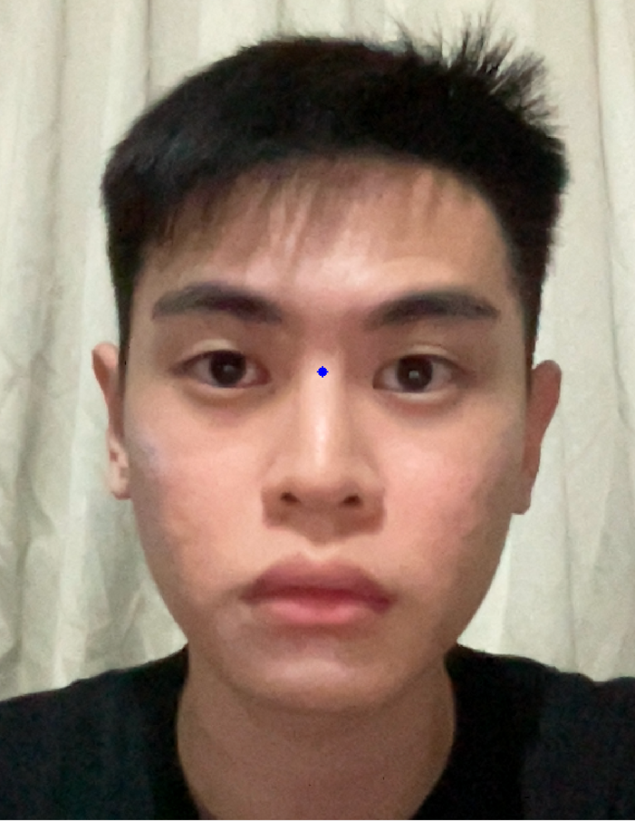
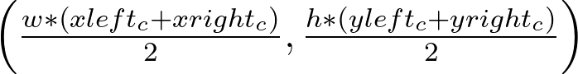
03 IMPLEMENTATION
EYE TRACKING
Tracking point
Notes:
The middle point between the centres of the left and right eyes was used as the tracking point for the eye typing system. The point was calculated by averaging the x and y coordinates of the two eye centres.

Slide 18
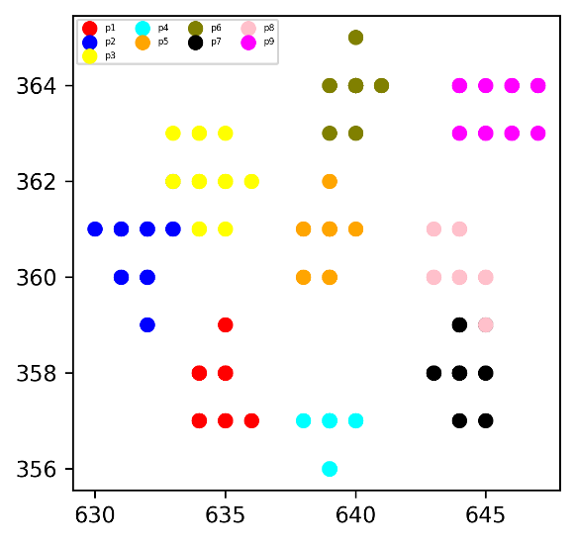
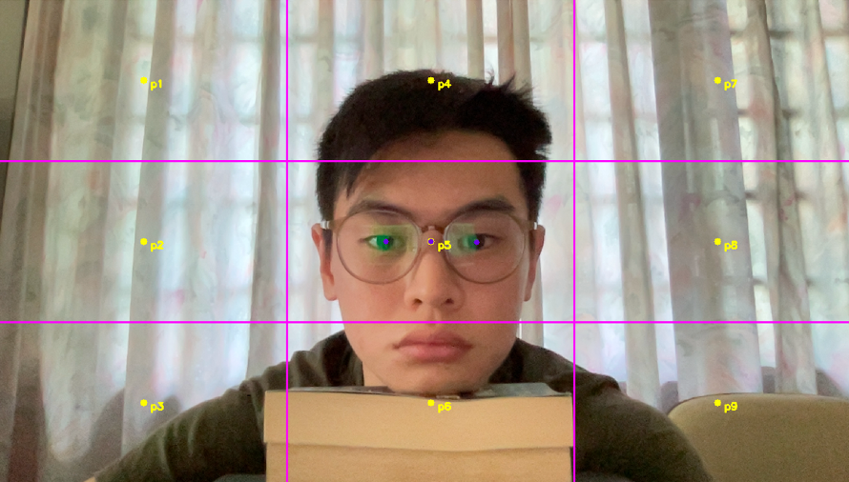
03 IMPLEMENTATION
GAZE ESTIMATION - RELATING TRACKING POINT TO GAZE POINT
LINEAR RELATIONSHIP
Notes:
To develop the gaze estimation model, a preliminary study was conducted to establish a relationship between the tracking point and the gaze point.
[CLICK]
9 gaze points were plotted on the computer screen and each point was sequentially gazed at. The coordinates of the tracking point were recorded at each gaze.
To ensure consistency in the head pose, the chin rest was used to support my head and prior to each recording, the tracking point was aligned with p5. For each gaze points, 20 tracking point coordinates were recorded.
[CLICK]
The tracking points were then plotted out using the Matplotlib package and the results are shown on the right. Looking at both images, it is evident that the plots of the tracking point align with the gaze points.
[CLICK]
This linear alignment indicates that a linear relationship exists between the tracking point and the gaze points.

Slide 19
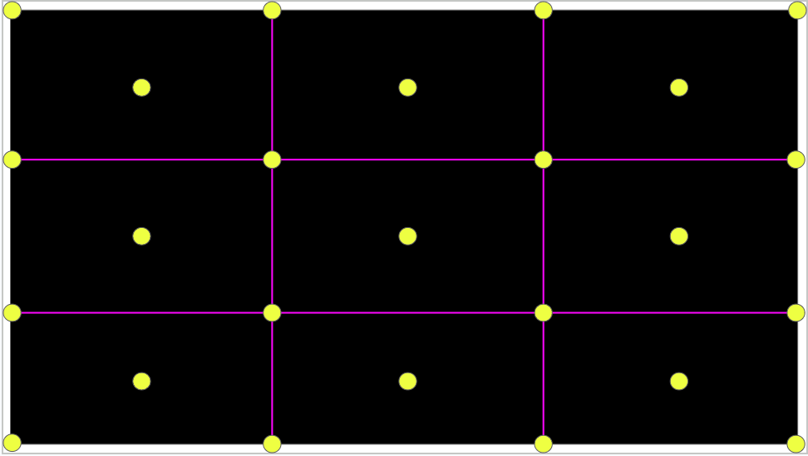
03 IMPLEMENTATION
GAZE ESTIMATION - DATA COLLETION
Collect more data
16 additional gaze points
Generate a random gaze point every 10 seconds within each grid, 20 per grid
Total of 680 tracking points collected
Notes:
Having established a linear relationship between the tracking point and gaze points, linear regression model can be constructed.
To collect more data, 16 additional gaze points were plotted on the computer screen and the same process of recording the coordinates of the tracking point while looking at each of these new gaze points was repeated.
Additionally, a script was developed to generate a random gaze point every 10 seconds within each grid. For each grid, 20 random gaze points were generated.
A total of 680 tracking point coordinates were recorded.

Slide 20
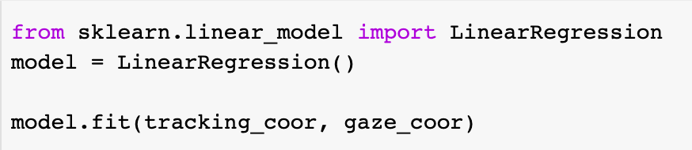
03 IMPLEMENTATION
GAZE ESTIMATION - LINEAR REGRESSION MODEL
Scikit-Learn library's linear regression model
X – mean tracking point coordinates
Y - gaze coordinates
Notes:
To generate the gaze estimation model, the mean of coordinates of the tracking point for each gaze point were calculated.
The Scikit-Learn library's linear regression model was then utilised to fit the tracking point coordinates as the X parameter and the gaze coordinates as the Y parameter

Slide 21
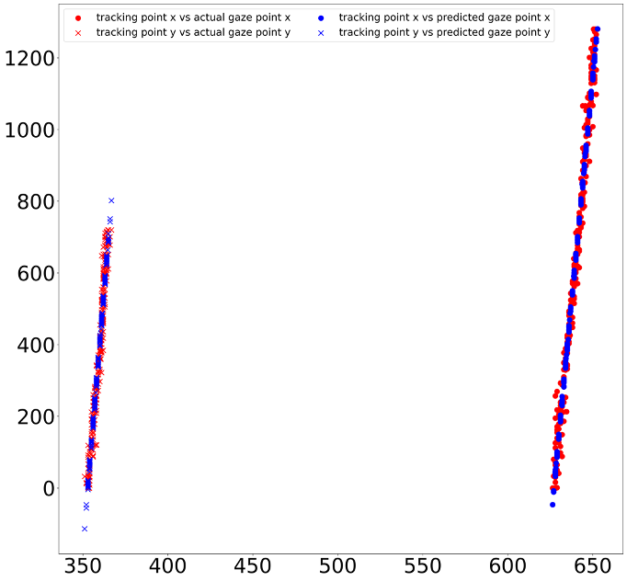
03 IMPLEMENTATION
GAZE ESTIMATION - LINEAR REGRESSION MODEL
Model Accuracy
R score - 0.953
Plot the graphs of tracking point coordinates against both the actual gaze coordinates and the model-predicted gaze coordinates
2
Notes:
To evaluate the accuracy of the gaze estimation model, the R2 score was calculated.
The R2 score value was 0.953, indicating a high accuracy
The graphs of the tracking point coordinates against both the actual gaze coordinates and the model-predicted gaze coordinates were also plotted. The plots shows that the two graphs closely align, indicating a strong match between the model estimates and the actual data.

Slide 22
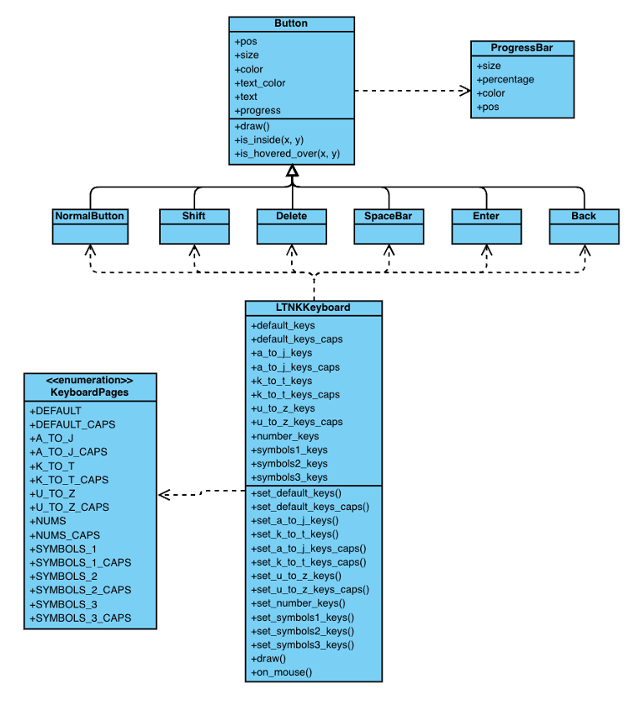
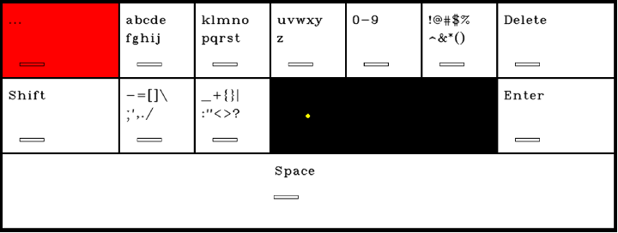
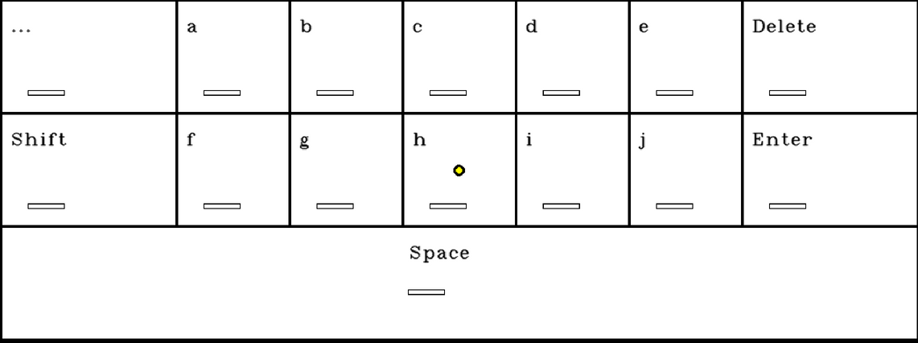
03 IMPLEMENTATION
LTNK KEYBOARD
Notes:
To develop the LTNK keyboard, an object-oriented programming approach was used.
The figure on the left shows the class diagram of the LTNK keyboard. The LTNK keyboard class comprises of various button classes and has functions to switch between keyboard pages and output key selections
The figure on the right shows the keyboard. Each key has a progress bar to indicate the progress of the dwell selection. The yellow dot in the middle indicates the centre of the screen and serves as a reference point for users to maintain their head pose

Slide 23
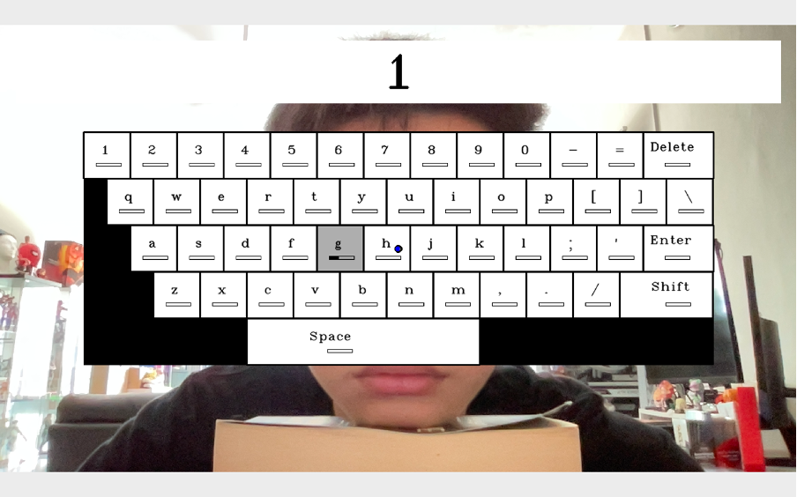
03 IMPLEMENTATION
GUI
Display for selected keys
Keyboard situated in the centre
Notes:
This is the GUI of the eye typing system.
The top white bar displays the output of the selected keys
The keyboard is situated in the center of the screen

Slide 24

04 USER STUDIES
SETUP
Same setup is used for all user studies
Data collected:
Sequence of typing prompts
Sequence of participants' inputs
Time taken to eye type each input
Notes:
I will now discuss the user studies conducted. Four user studies were conducted in total.
The same experimental setup was used for all user studies conducted.
The data collected in all experiments included the sequence of typing prompts, the participants’ inputs, and the time taken to eye type each input.

Slide 25
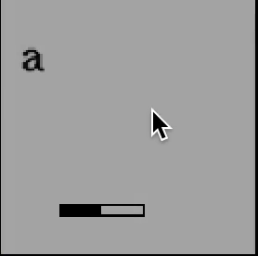
01 USER STUDIES
i. DETERMINING APPROPRIATE DWELL TIME
OBJECTIVES
Determine the appropriate dwell time for comparing the QWERTY and LTNK keyboards
Appropriate if:
Average typing accuracies: [85%, 100%]
Accuracies are within 5% of each other
Notes:
The first user study was conducted to determine the appropriate dwell time to use for comparing the QWERTY and LTNK keyboards
In this experiment, a dwell time is considered appropriate if:
The typing accuracies using the dwell time is between 85-100%
And the accuracies are within 5% of each other

Slide 26
04 USER STUDIES
i. DETERMINING APPROPRIATE DWELL TIME
METHOD
Dwell times tested: 800ms, 500ms and 400ms
Order:
QWERTY, LTNK
800ms, 500ms, 400ms
Two phases:
Practice - Get familiar with eye typing with the corresponding dwell time
Test - Eye type a set of 20 characters as fast and accurate as possible
Notes:
In this study, dwell times of 800, 500 and 400ms were tested
All participants performed the user study in the same order, starting with the QWERTY keyboard followed by the LTNK keyboard, with the dwell time descending from 800ms to 400ms for both keyboards.
Each dwell time was divided into two phases: a practice phase and a test phase.
The practice phase is a 10 minutes practice session where participants get familiar with eye typing with the corresponding dwell time.
In the test phase, participants were required to eye type, as quickly and accurately as possible, a set of 20 characters that were displayed one after another.

Slide 27
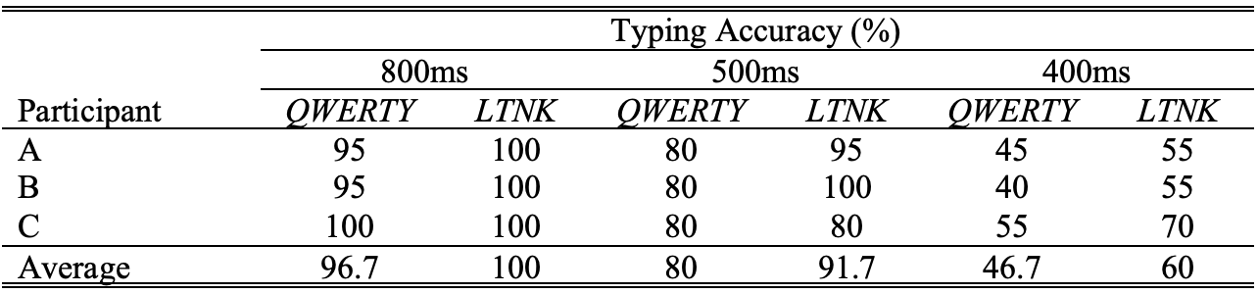
04 USER STUDIES
i. DETERMINING DWELL TIME TO USE
RESULTS
Notes:
These are the results of the user study
As dwell time decreased, the typing accuracy for both keyboards decreased.
A shorter dwell time causes the ‘Midas Touch Problem’ where every key a user gazes at becomes a selection, even if the user was moving across the keyboard to find the desired key to select.
In general, the typing accuracy of the QWERTY keyboard is lower than that of the LTNK keyboard. This is because the QWERTY keyboard has smaller keys and more keys in a given area than the LTNK keyboard. This causes more errors to occur in typing as the gaze estimation model cannot accurately distinguish between the gaze coordinates for the intended key and the neighbouring keys.
[CLICK]
From the results, we can conclude that the most appropriate dwell time to use for the remaining user study is 800ms as typing accuracies for keyboards are within the range of 85% to 100% and are within 5% of each other. All user studies conducted subsequently used an 800ms dwell time.

Slide 28
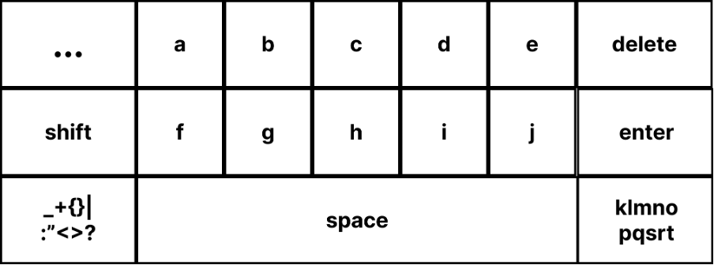
04 USER STUDIES
ii. IMPROVING NAVIGATION EFFICIENCY OF LTNK
OBJECTIVES
Improve navigation between adjacent level two pages
Initial design incurs a two-button selection penalty
Add two carousel buttons on each level two page, reduce penalty to one-button
Notes:
The initial design of the LTNK keyboard incurred a two-button selection penalty between adjacent level two pages.
In order to reduce the switching cost between adjacent level two keyboard pages, a design variation was proposed to include two carousel buttons on each level two page. This would reduce the penalty to just one button
Hence, the 2nd study was conducted to test if this design modification helped to switching time between adjacent level two keyboards and in turn increase typing speed.

Slide 29
04 USER STUDIES
ii. IMPROVING NAVIGATION EFFICIENCY OF LTNK
METHODS
Users split into two groups: Group A and Group B
A - Initial Design first, New Design second
B - New Design first, Initial Design second
Two phases for each design:
Practice - Get familiar with eye typing with the corresponding dwell time
Test - Eye type a set of 20 characters as fast and accurate as possible
Each set of characters required users to make the same keyboard page switches
Notes:
Complete counterbalancing was used to prevent any order effects
The participants were split into 2 groups A and B
Group A performed the tests with the initial design first, new design second
Group B performed the test in the opposite order
Like the previous user study, there were two phases: practice and test
In the test phase, Each set of characters required users to make the same keyboard page switches

Slide 30
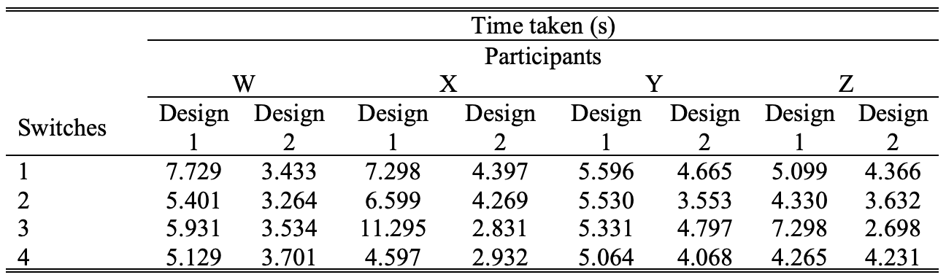
04 USER STUDIES
ii. IMPROVING NAVIGATION EFFICIENCY OF LTNK
RESULTS
Design 1 - Initial design
Design 2 - New design
Notes:
These are the results of the experiment
[CLICK]
It is evident that the new design achieved faster switching time between adjacent level two pages for all participants
This indicates that the design modification effectively reduces the time taken to switch between adjacent level two pages and improves the overall speed of eye typing on the LTNK keyboard.
As a result, the LTNK keyboard will adopt the new design and this new design will be utilized in next user studies.

Slide 31
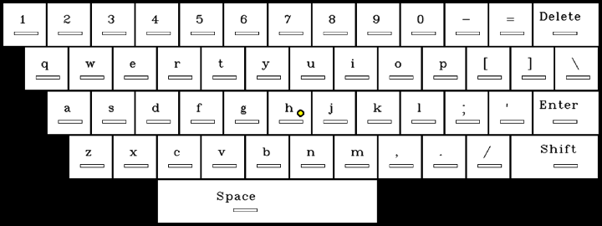
04 USER STUDIES
iii. LTNK KEYBOARD VS QWERTY KEYBOARD
OBJECTIVES
Compare users’ typing performance when using the LTNK keyboard and the QWERTY keyboard
VS
Notes:
The third user study compares users’ typing performance when using the LTNK keyboard and the QWERTY keyboard. The metrics evaluated were users’ typing speed, typing accuracy and overall user satisfaction.

Slide 32
04 USER STUDIES
iii. LTNK KEYBOARD VS QWERTY KEYBOARD
METHODS
Users split into two groups: Group A and Group B
A - QWERTY first, LTNK second
B - LTNK first, QWERTY second
Two phases for each keyboard:
Practice - Get familiar with eye typing with the corresponding dwell time
Test - Eye type a set of 20 characters as fast and accurate as possible
Pattern of five keys that were far apart from each other, followed by five keys that were next to each other, alternating
Participants filled up a Google Form to provide feedback on their overall user experience
Notes:
Similar to user study 2, the users were split into 2 groups: A and B
A performed the test using the qwerty keyboard first, ltnk second
B performed the test in the opposite order
Again, there were 2 phases: practice and test
For the test phase, sequence of characters follow a pattern of 5 keys that are far apart and 5 keys that were next to each other, alternating
After the tests, the participants had to fill up a Google Form to provide feedback on their overall user experience

Slide 33
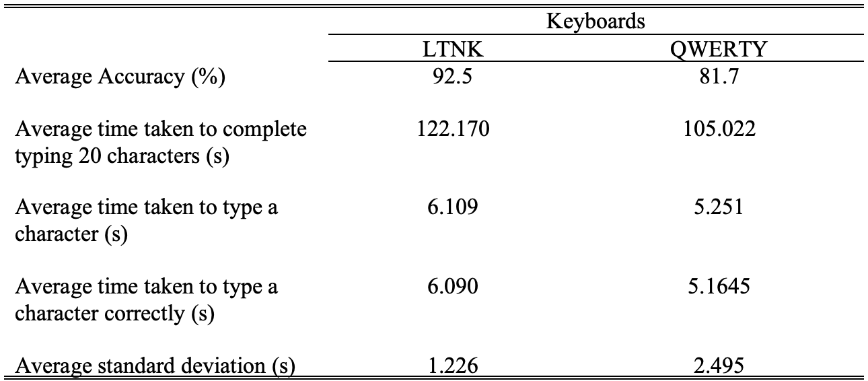
04 USER STUDIES
iii. LTNK KEYBOARD VS QWERTY KEYBOARD
RESULTS
Notes:
These are the results of the user study.
The accuracy of achieved by the ltnk was higher, which matched the result of the 1st user study
Generally, it took longer for participants to type a character using the LTNK keyboard. This may be due to its hierarchical nature, which requires more keystrokes compared to the QWERTY keyboard. OR that users were more familiar with the qwerty keyboard.
However, the LTNK keyboard had a smaller standard deviation than the QWERTY keyboard, indicating that the time taken to select keys, whether close or far apart, was consistent on the LTNK keyboard, unlike the QWERTY keyboard.
This suggests that the LTNK keyboard may be more suitable for tasks that require precision and consistency, while the QWERTY keyboard may be more suitable for tasks that require speed and ease of use

Slide 34
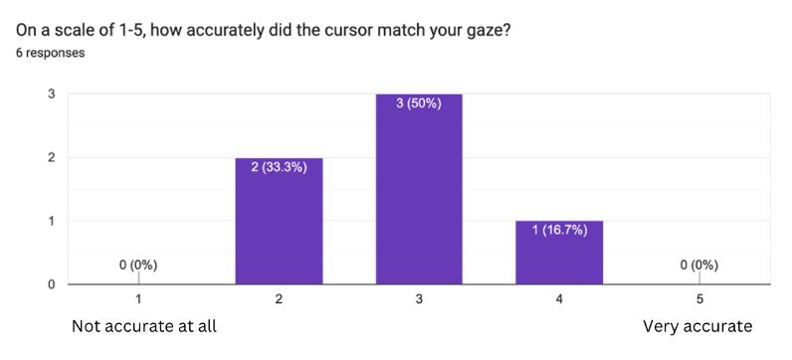
04 USER STUDIES
iii. LTNK KEYBOARD VS QWERTY KEYBOARD
Gaze Accuracy:
2.83/5 👎
Notes:
The graph shows users’ perception of the accuracy of the gaze tracking.
The mean score calculated for the eye typing systems’ gaze accuracy was 2.83 out of 5
Participants perceived the gaze tracking accuracy to be inadequate

Slide 35
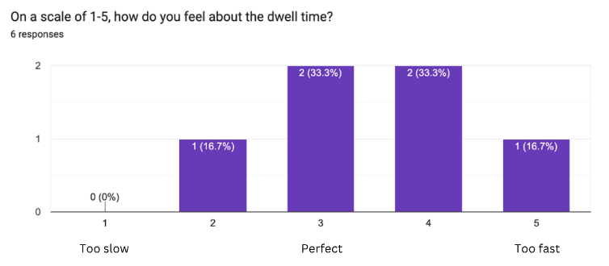
04 USER STUDIES
iii. LTNK KEYBOARD VS QWERTY KEYBOARD
Dwell Time:
3.5/5 👍
Notes:
The graph shows users’ perception of the dwell time.
The mean score calculated was 3.5 out of 5
Participants perceived the dwell time to be satisfactory.

Slide 36
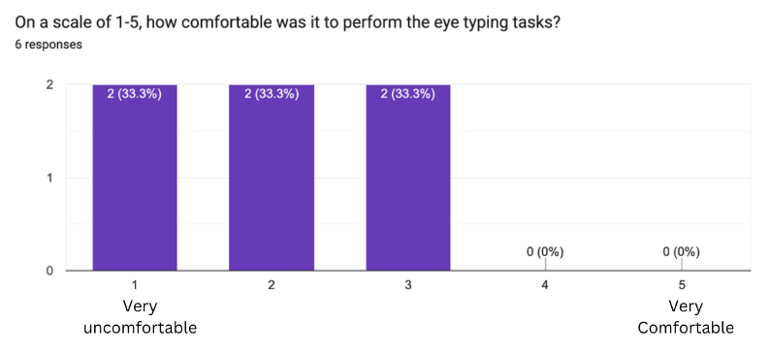

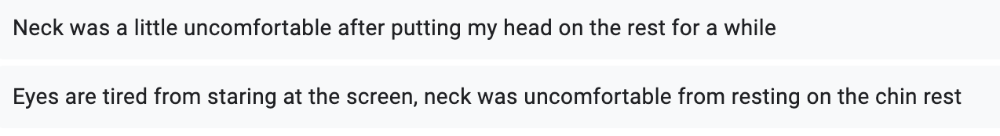
04 USER STUDIES
iii. LTNK KEYBOARD VS QWERTY KEYBOARD
Comfort:
2/5 👎
Notes:
In terms of the comfortability of the eye typing setup:
Participants found it to be uncomfortable
In addition, participants provided comments such as:
“Neck was a little uncomfortable after putting my head on the rest for a while.”
“Eyes are tired from staring at the screen, neck was uncomfortable from resting on the
chin rest.”
“My eyes tired.”

Slide 37
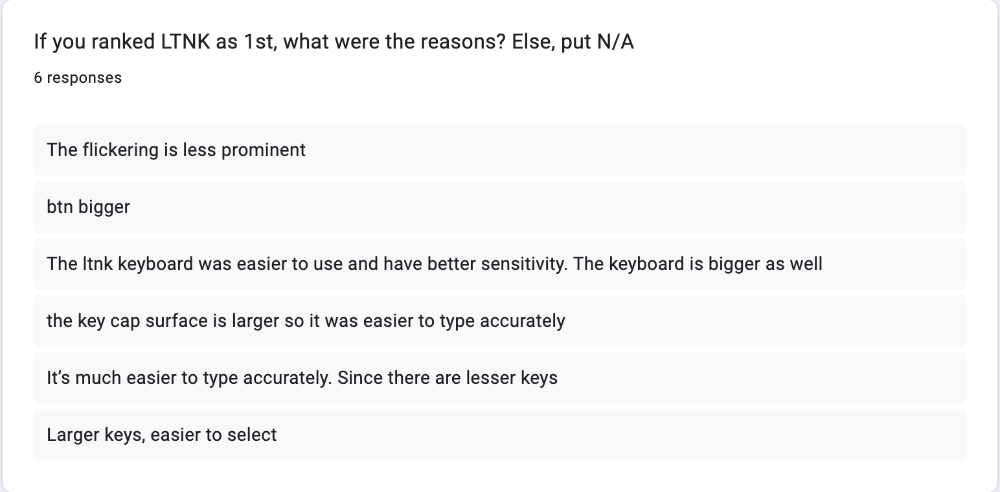
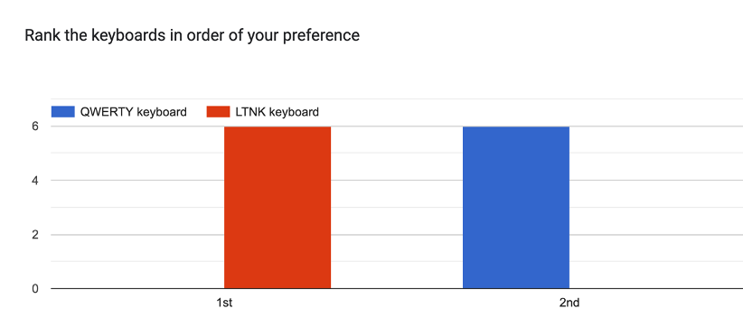
04 USER STUDIES
iii. LTNK KEYBOARD VS QWERTY KEYBOARD
Notes:
All users preferred the ltnk keyboard over the qwerty keyboard
Users indicated:
LTNK keyboard had larger keys than the QWERTY keyboard, making it easier to accurately select the desired key.

Slide 38
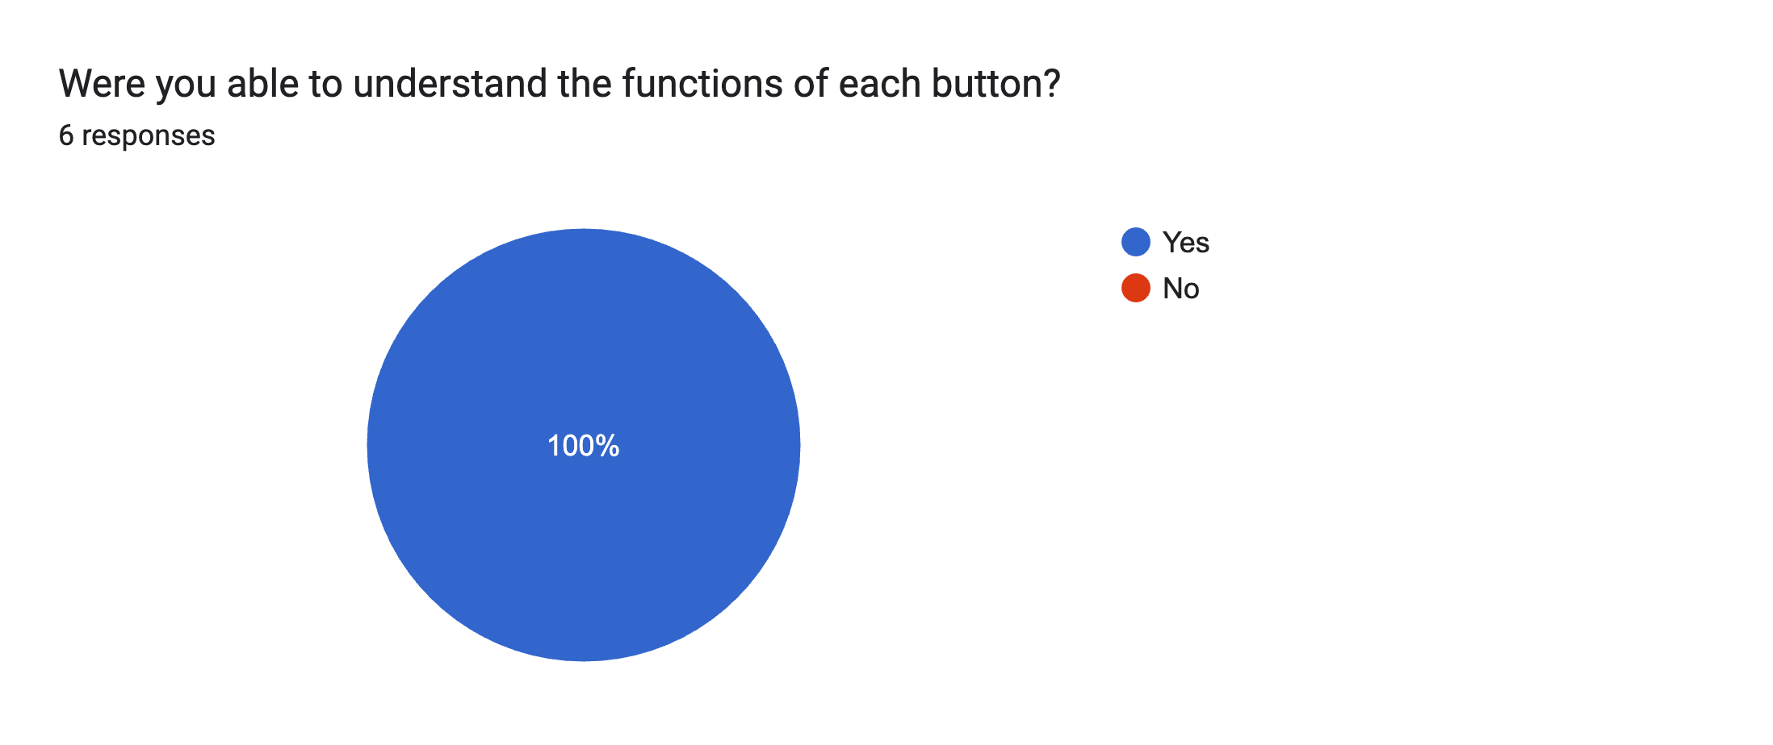
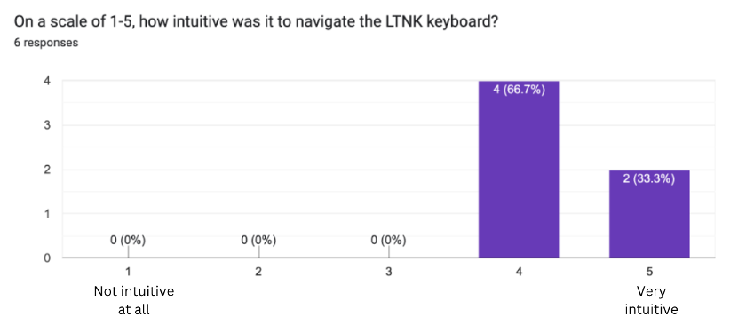
04 USER STUDIES
iii. LTNK KEYBOARD VS QWERTY KEYBOARD
Intuitiveness:
4.33/5 👍
Notes:
In terms of intuitiveness, users generally found the ltnk keyboard to be easy to use.
Additionally, all participants responded “Yes” when asked if they could understand the functions of all the buttons, further supporting the keyboard’s perceived ease of use.

Slide 39
04 USER STUDIES
iv. EFFECT OF REPEATED USE OF THE LTNK KEYBOARD ON TYPING SPEED
OBJECTIVES
Determine whether repeated use of the LTNK keyboard will lead to faster typing speeds
METHODS
Split into one practice phase and three test phases
Each participant had to type the same set of 20 characters three times
Notes:
From the results of user study 3, we know that the typing speed on the qwerty keyboard was faster. The last user study aims to determine if repeated use of the LTNK keyboard will lead to faster typing speeds.
For this experiment, users had to type the same set of characters three times, and their typing speeds were recorded and analysed.

Slide 40
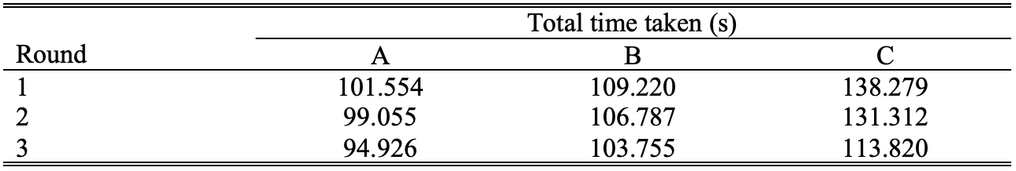
04 USER STUDIES
iv. EFFECT OF REPEATED USE OF THE LTNK KEYBOARD ON TYPING SPEED
RESULTS
Notes:
These are the results.
In general, there is a decrease in the total time taken to type the same 20 characters. However, none of the total time reached that of the qwerty keyboard in user study 3
This shows that while repeated use of the ltnk keyboard could increase proficiency in using the keyboard, the qwerty keyboard is still better in terms of speed.

Slide 41
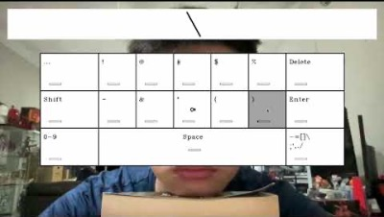
04 USER STUDIES
DEMO
Notes:
Before I move on to the conclusion, I would like to show a demonstration of eye typing on the LTNK keyboard

Slide 42
05 CONCLUSION
LTNK KEYBOARD
Higher accuracy than the QWERTY
Typing speed is slower than QWERTY
Repeated use LTNK led to faster typing speeds
Did not surpass that of the QWERTY
Participants favoured the LTNK over QWERTY
Notes:
The results from user study 3 showed that while the LTNK keyboard had a higher accuracy than the QWERTY keyboard, typing speed was still slower than qwerty
User study 4 showed that typing speed could be improved from repeated use of the keyboard, but the results never surpassed that qwerty
User study 3 also showed that participants preferred LTNK keyboard over the QWERTY keyboard as the larger keys compensated for the inaccuracies in gaze estimation, making it easier to type.
Overall, ltnk keyboard is still a viable virtual keyboard option for eye typing.

Slide 43
05 CONCLUSION
EYE TYPING SYSTEM
Inaccurate gaze estimation
Uncomfortable
Can be improved by using deep learning
Notes:
From user study 3, participants felt that the gaze tracking was overall inaccurate and that the eye typing setup was uncomfortable.
These issues can be improved by implementing more sophisticated gaze tracking methods, such as using deep learning, to remove the need for having a fixed head pose.

Slide 44
THANK YOU

